Slide 1


of Wikipedia:
Knowledge-Powered Conversational Agents
*Emily Dinan, *Stephen Roller, *Kurt Shuster, (*joint first authors)
Angela Fan, Michael Auli, Jason Weston
Facebook AI Research

Slide 2
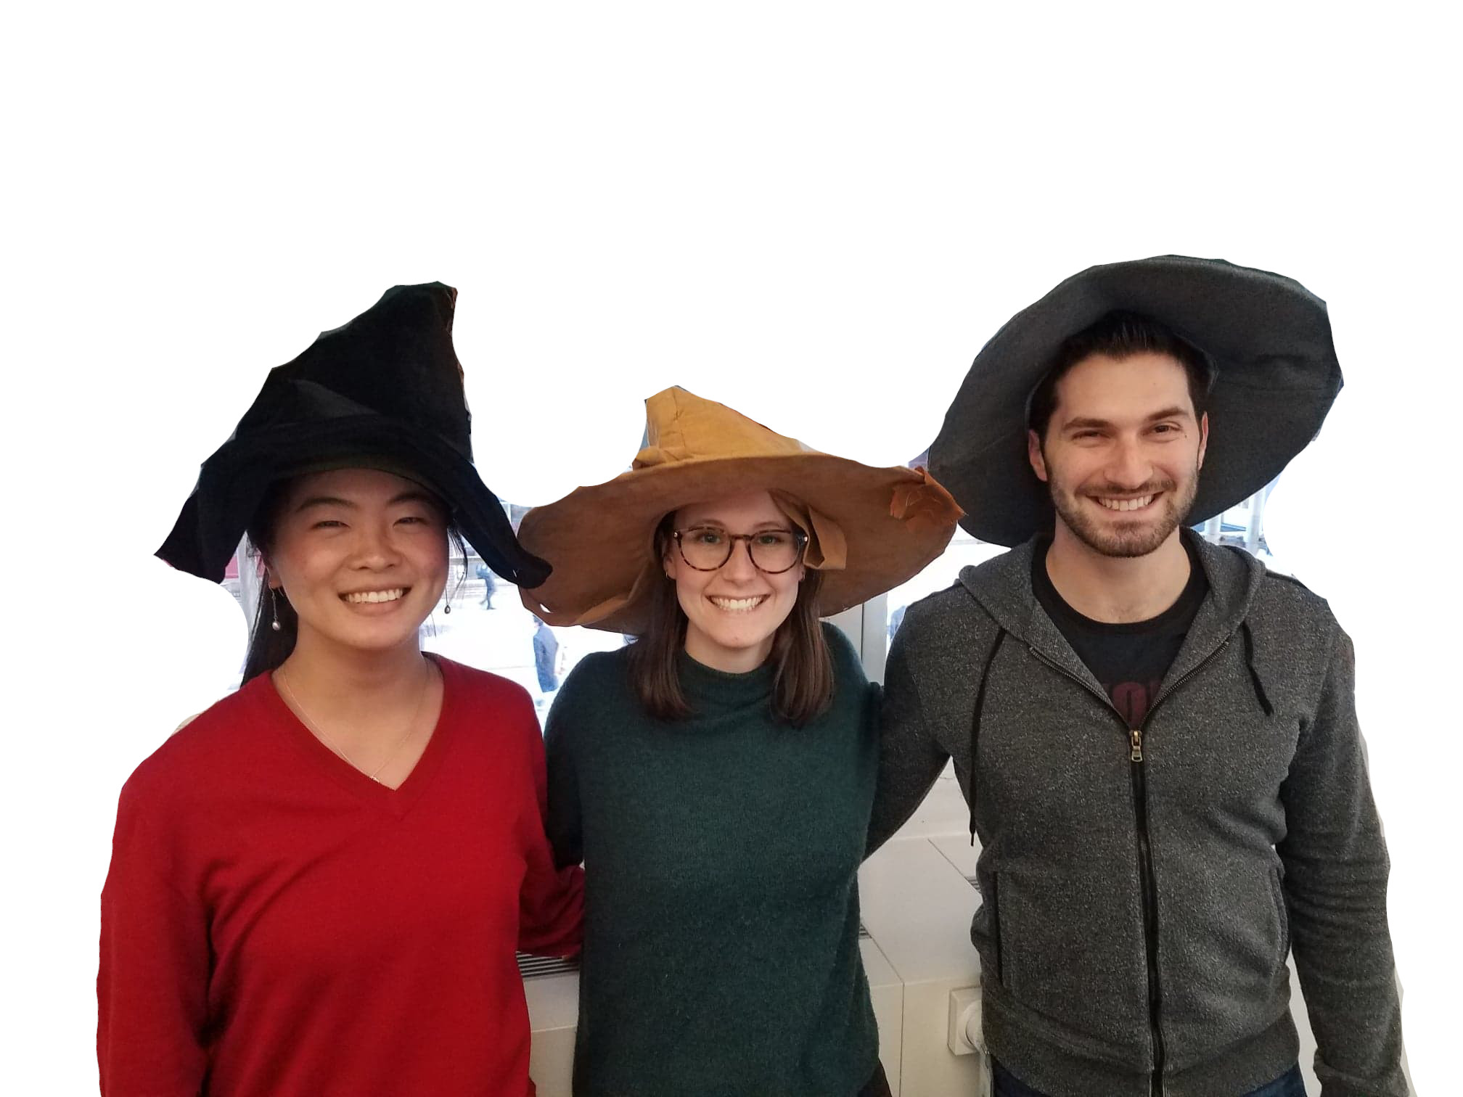
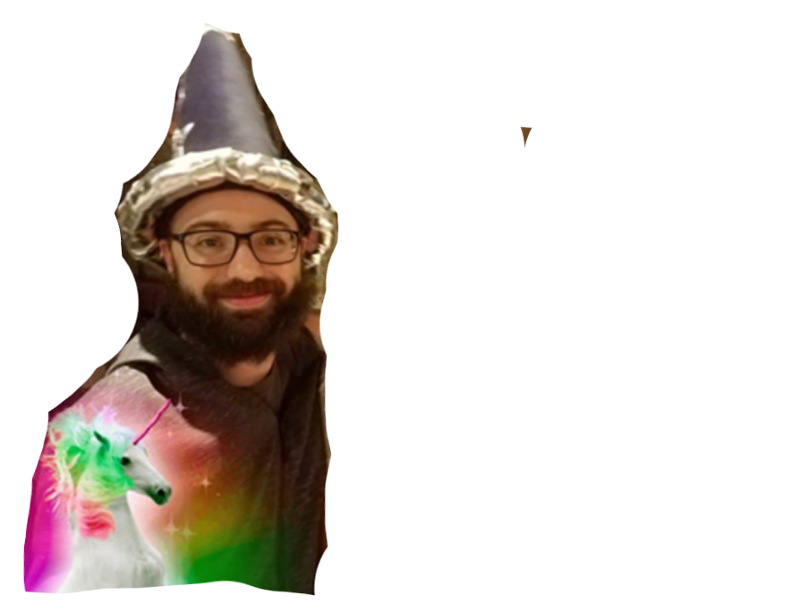
of Wikipedia:
Knowledge-Powered Conversational Agents
*Emily Dinan, *Stephen Roller, *Kurt Shuster, (*joint first authors)
Angela Fan, Michael Auli, Jason Weston

Slide 3
Current chatbots just chat, they aren’t (em)powered with knowledge
Seq2Seq models take in last lines of dialog, output a sentence
We should ground on concrete information, rather than “generate and hope”

Slide 4
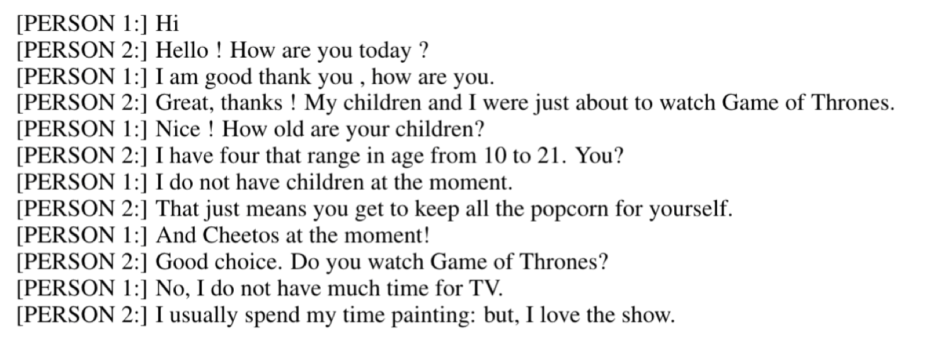
Current chatbots just chat, they aren’t (em)powered with knowledge
Seq2Seq models take in last lines of dialog, output a sentence
We should ground on concrete information, rather than “generate and hope”
E.g. many studies/models using non-knowledge-based chit-chat datasets:
Open-Subtitles (Vinyals & Le, 2015)
Persona-Chat (Zhang et al., 2018)
Twitter (Sordoni et al., 2015)

Slide 5
Existing Work
Goal directed dialogue uses knowledge :
but via an API on structured knowledge
e.g. restaurant or airline booking. (El Asri et al., 2017; Bordes et al., 2017)
Question-answering uses knowledge:
but can only answer questions
e.g. SQuAD (Rajpurkar et al., 2016) or QuAC (Choi et al., 2018)
can use a retriever over unstructured text, e.g. Open-SQuAD (Chen et al., 2017)
Text based Knowledge for dialogue:
Ghazvininejad et al. (2018) - local businesses using Foursquare tips as knowledge
Parthasarathi & Pineau (2018) - news articles using Wikipedia summaries
Moghe et al. (2018) – discuss movies given plot,reviews,etc.
“A Dataset for Document Grounded Conversations” Zhou et al., this EMNLP!
To our knowledge, no convincing demonstration yet of full multi-turn dialogue in an open-domain setting…

Slide 6
Open-Domain Dialogue Setting
Initial Starting Topic
Pair of speakers converse naturally.
They chat & learn from each other: discussion, facts, opinions.

Slide 7
Open-Domain Dialogue Setting
Initial Starting Topic
Pair of speakers converse naturally.
They chat & learn from each other: discussion, facts, opinions.
Non-symmetric speakers:
Apprentice: curious & eager to learn!
Wizard: knowledgeable on area, eager to discuss & be engaging.
Given an IR system to condition response on.
Clicks on sentences used.

Slide 8
1307 Diverse General Topics: crowd-sourced
Gouda cheese
commuting
music festivals
podcasts
bowling
Arnold Schwarzenegger
Alpine skiing
Bodybuilding supplement
Harley-Davidson
Miley Cyrus
Hamilton (musical)
Ireland
Cannabis (drug)
Mount Kilimanjaro
Eggplant
Welding
Aquarium
Italian cuisine
Mercedes-Benz S-Class
Peanut
German language
Chicago-style pizza
Black hair
Toga party
100 metres
Tiger
Smoking
Winter
Acrophobia
List of art media
Pet adoption
Influencer marketing
Vitamin C
Human height
Steak
Kurt Cobain
List of water sports
Strawberry
Online game
Text messaging
Baileys Irish Cream
Fiction
American football
Online shopping
Aldi
Rock and roll
Kendrick Lamar
Medical billing
Blue Ridge Parkway
Clown
Pasta
Hiking
Each Linked to Wikipedia

Slide 9
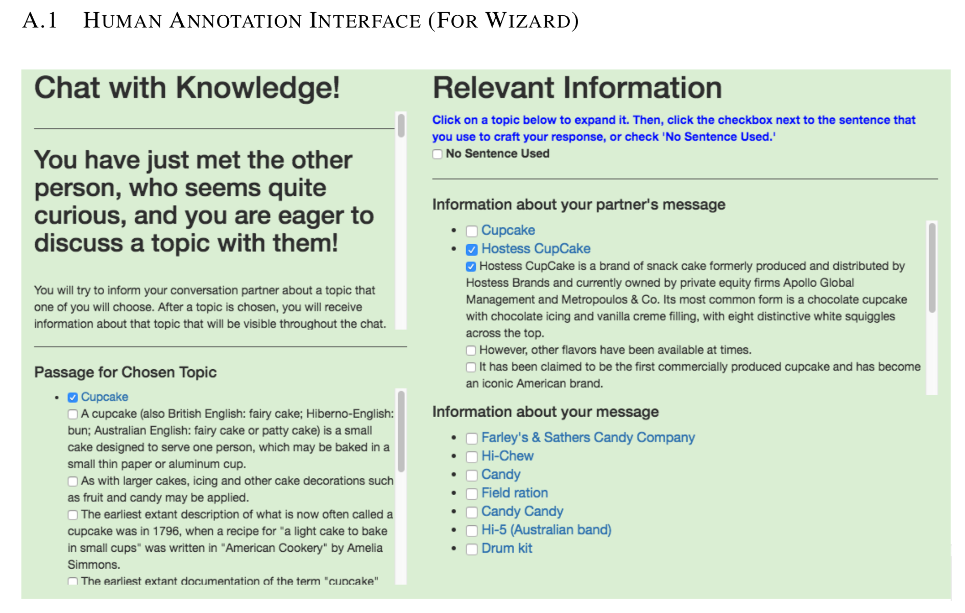

Slide 10
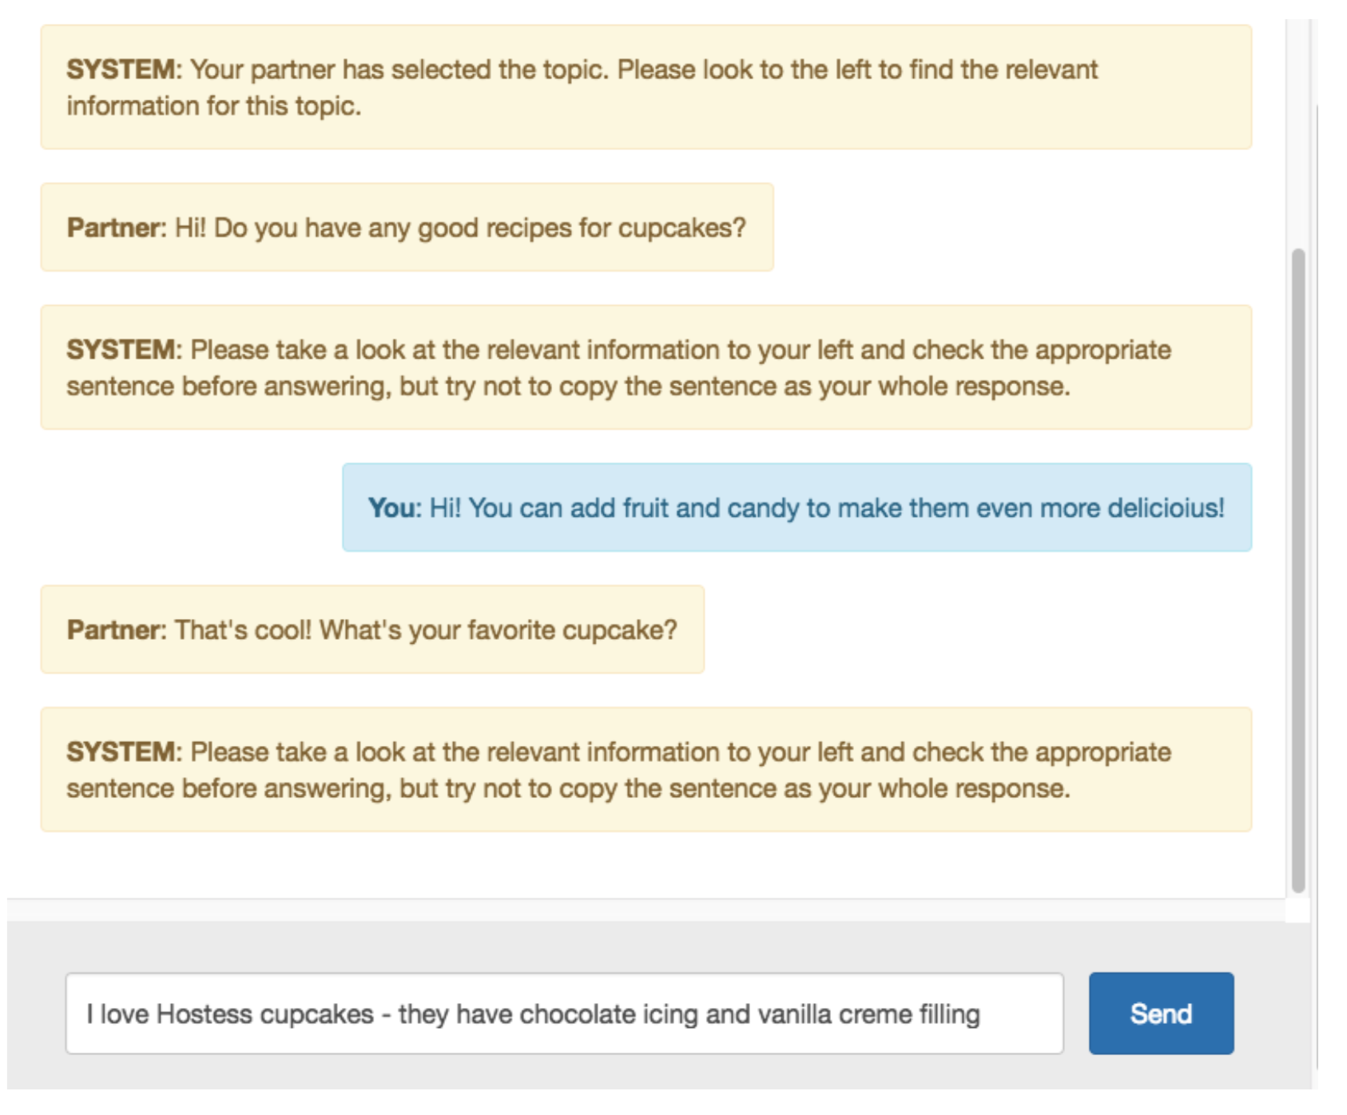

Slide 11
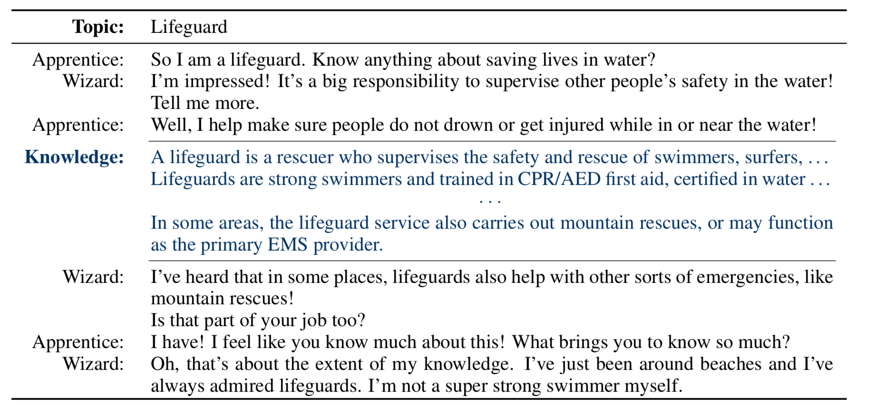
Dataset Examples

Slide 12
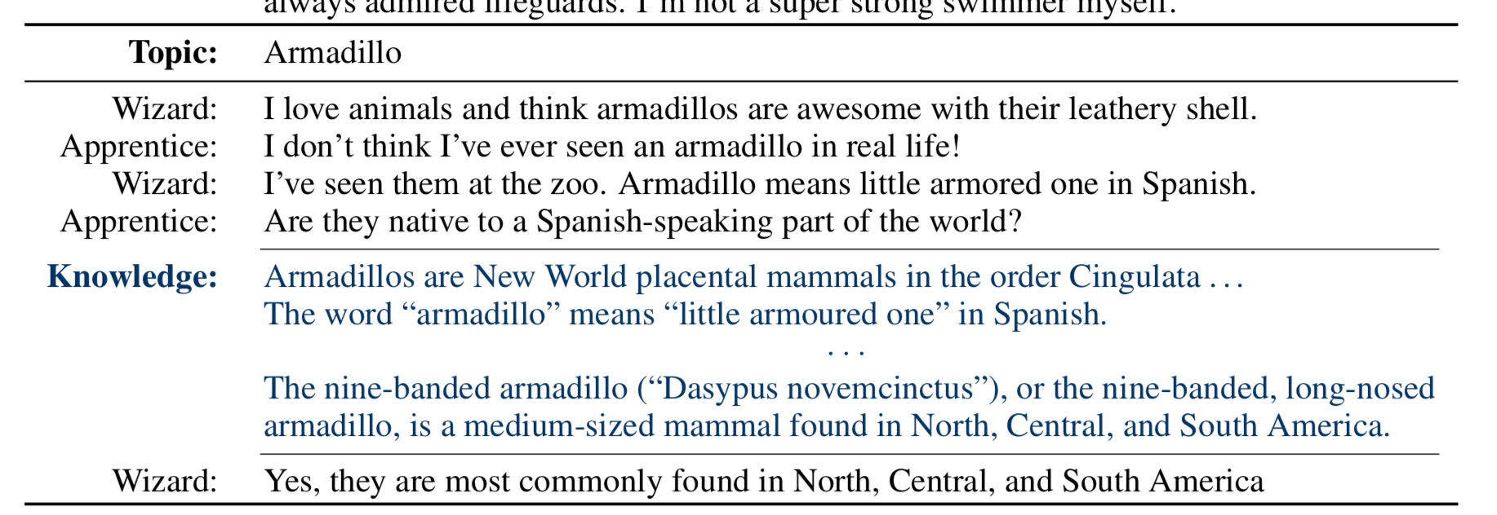
Dataset Examples

Slide 13
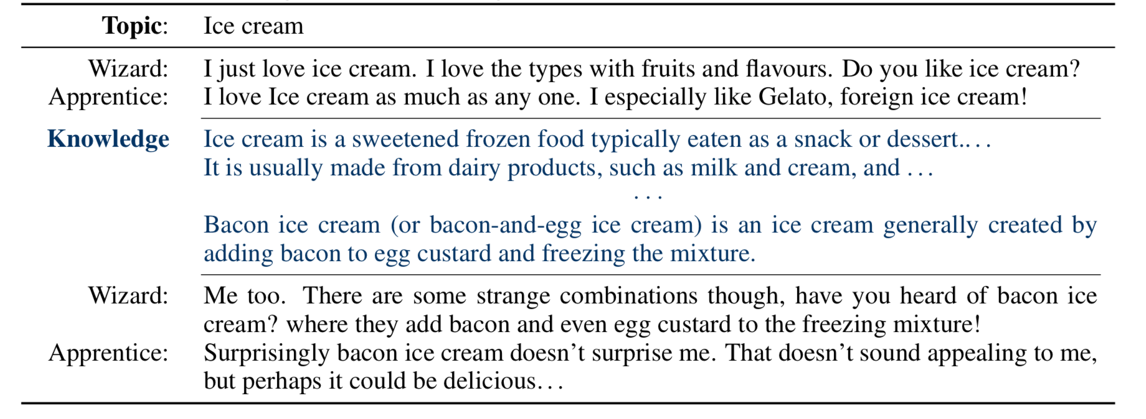
Dataset Examples

Slide 14
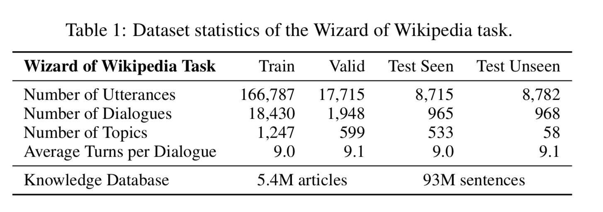

Slide 15
Models
If we can learn models on this data we think it could be (part of?) one of the best chatbots out there. Might actually want to talk to it?
Fun, engaging + knowledgeable !
Models require:
Read current dialogue
Retrieve knowledge (e.g. IR system, operates every turn)
Read/attend on results
Condition & generate something fun and knowledgeable!

Slide 16
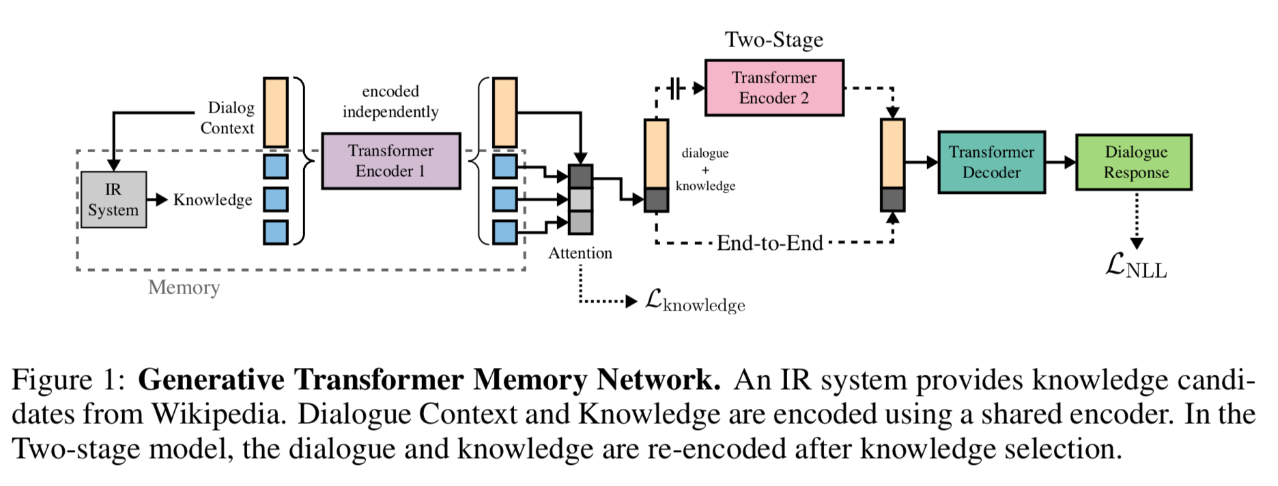
Generative Model architecture

Slide 17

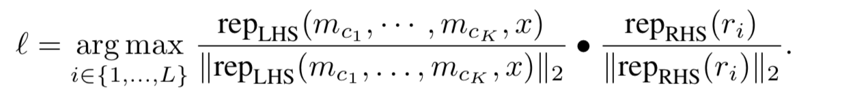
Retrieval Model architecture
Similar to generative model, but:
(1) we don’t attend to only the best returned knowledge (keep the weighted attention sum)
(2) we replace the decoder with ranker of encoded sentences:
Transformers pretrained on 1.7 billion Reddit dialogue examples, following (Mazare ́ et al., 2018). Shown to work very well for PersonaChat dialogue

Slide 18
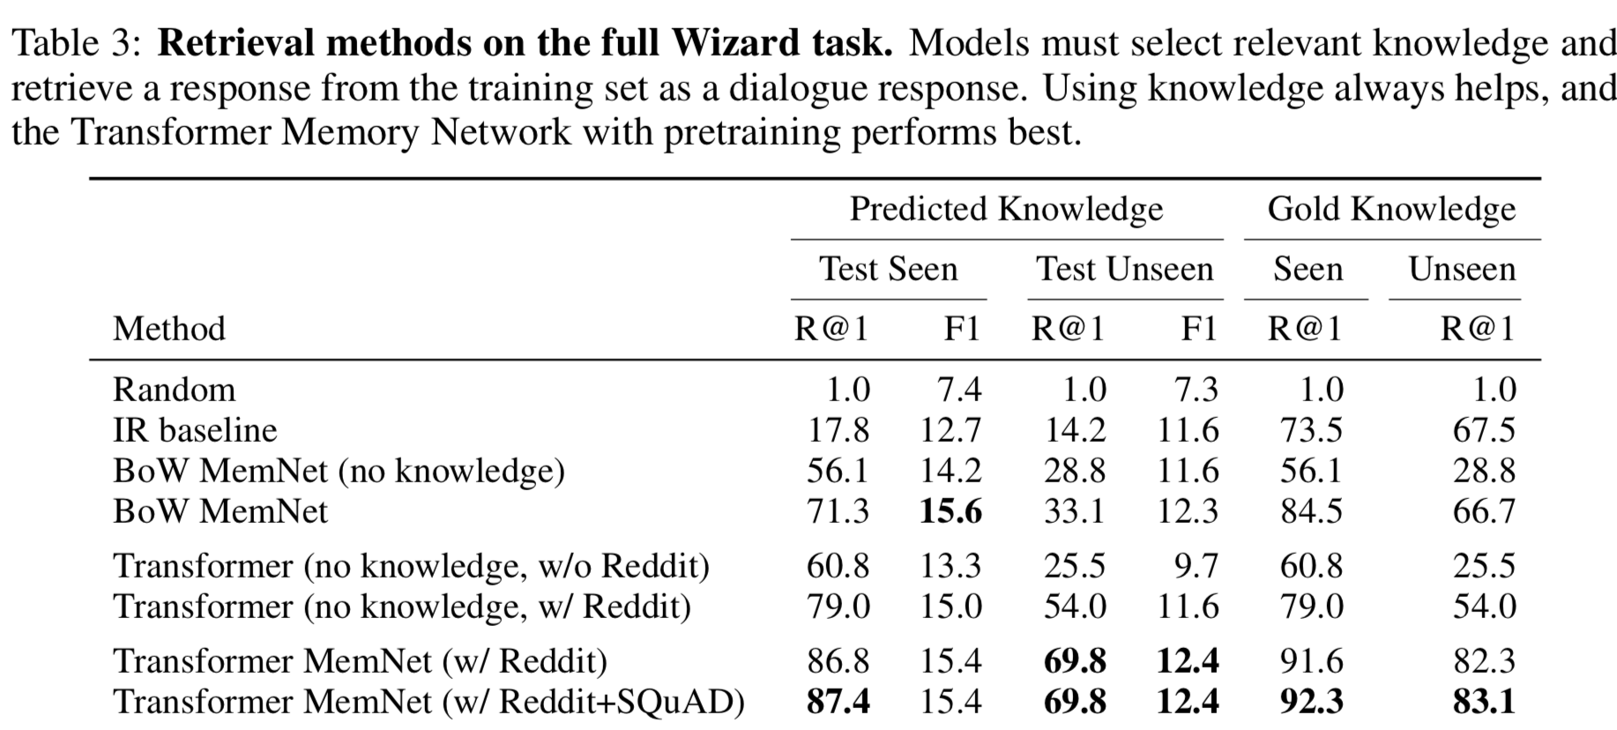
Full Dialogue Task: Retrieval

Slide 19
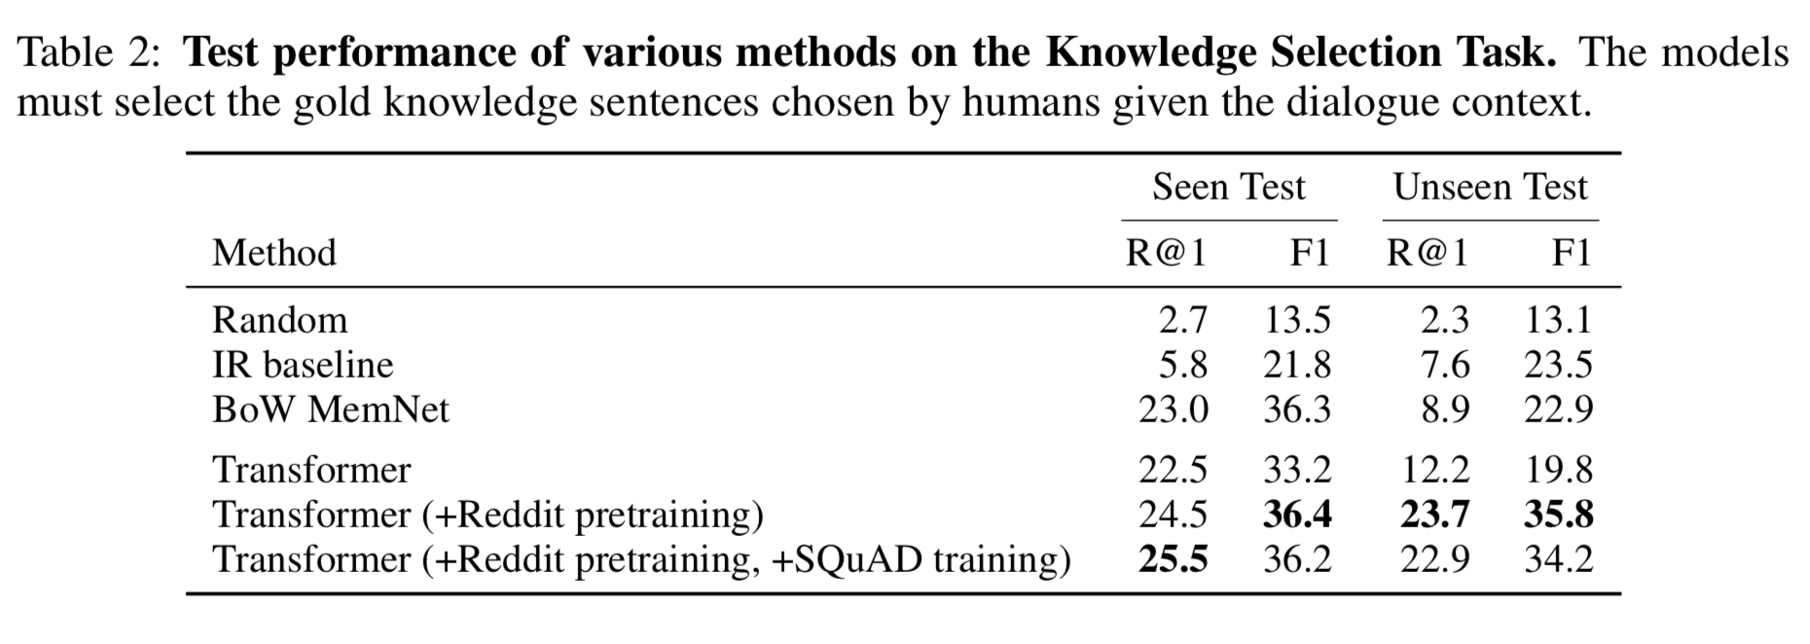
SubTask: Knowledge Selection

Slide 20
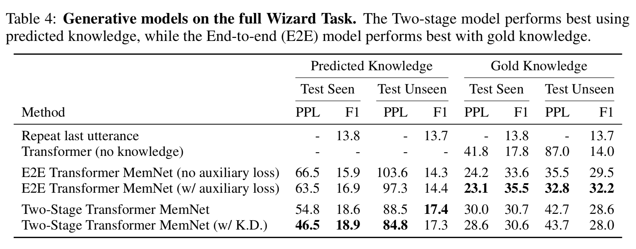
Full Dialogue Task: Generation

Slide 21
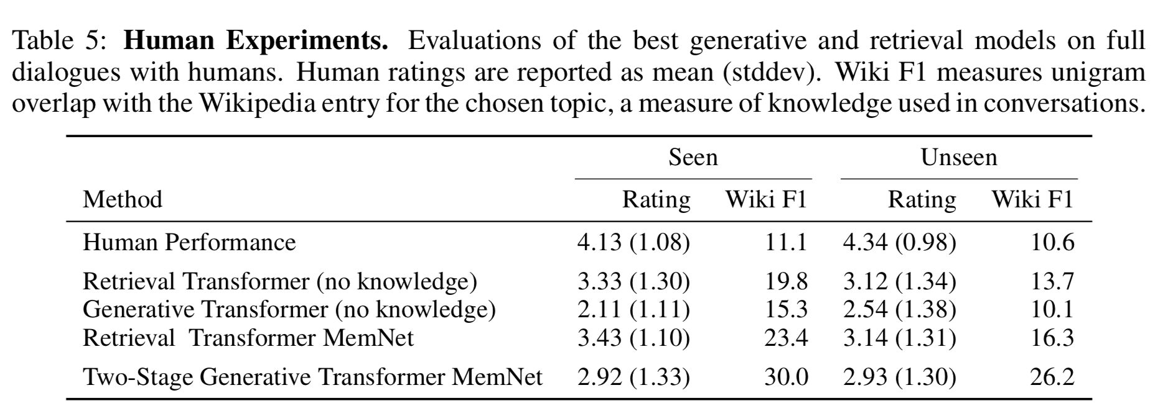
Human Evaluations

Slide 22
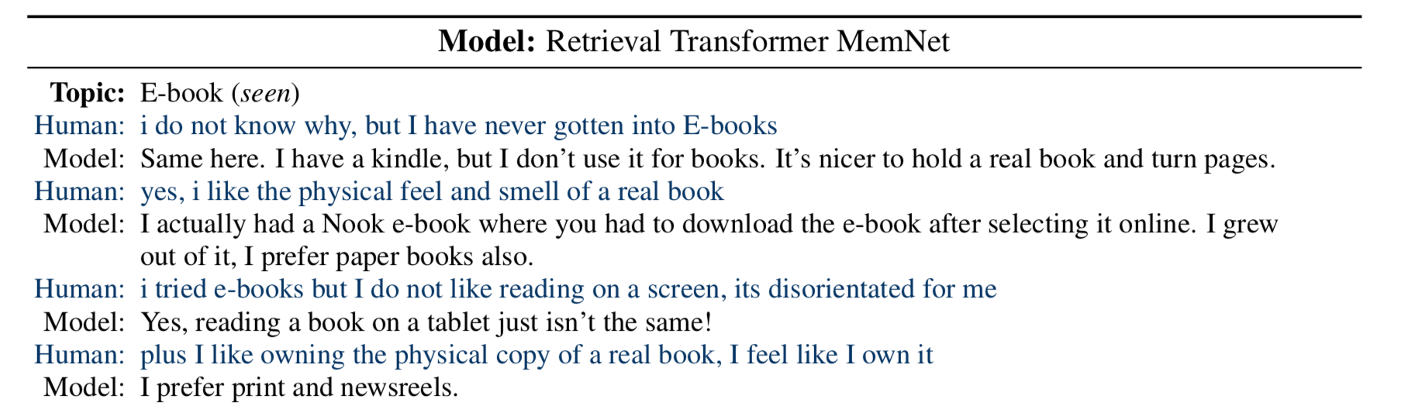
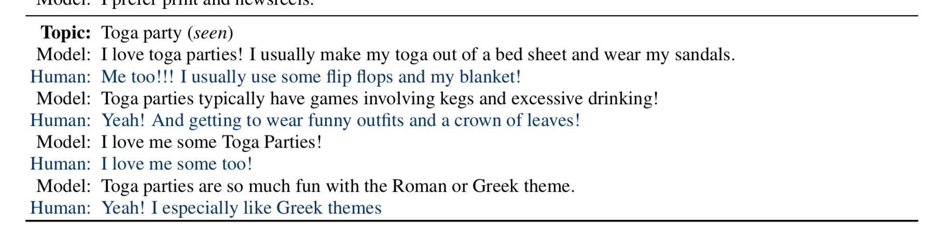

Slide 23
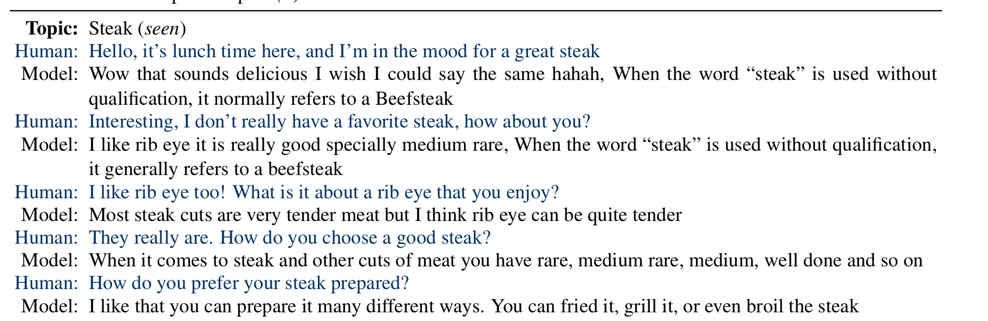
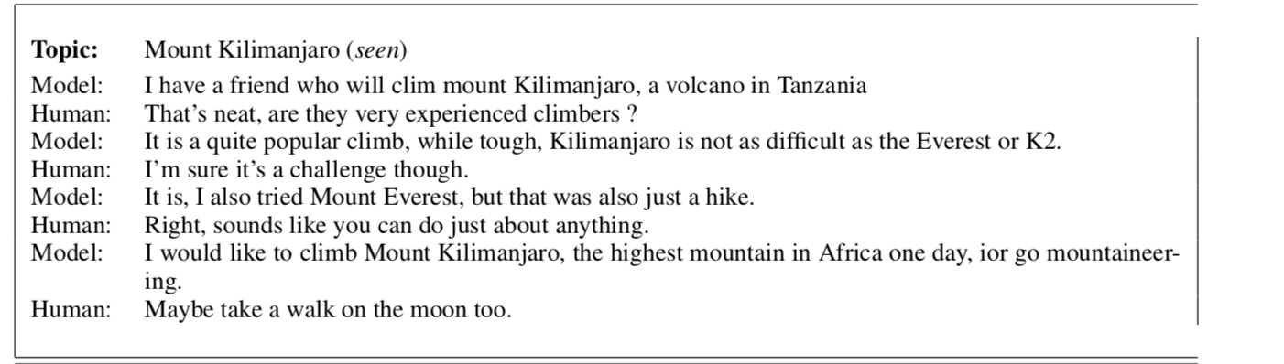

Slide 24
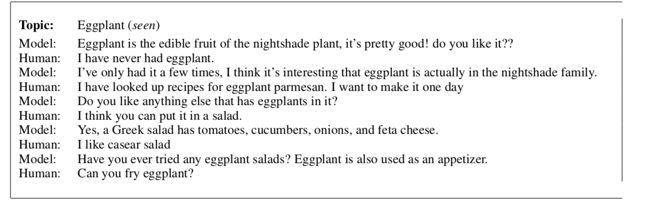
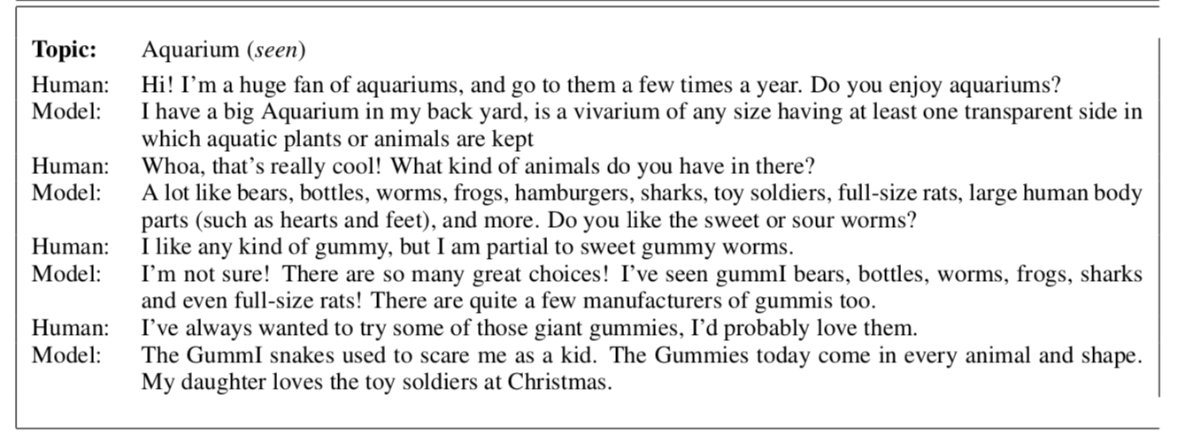

Slide 25
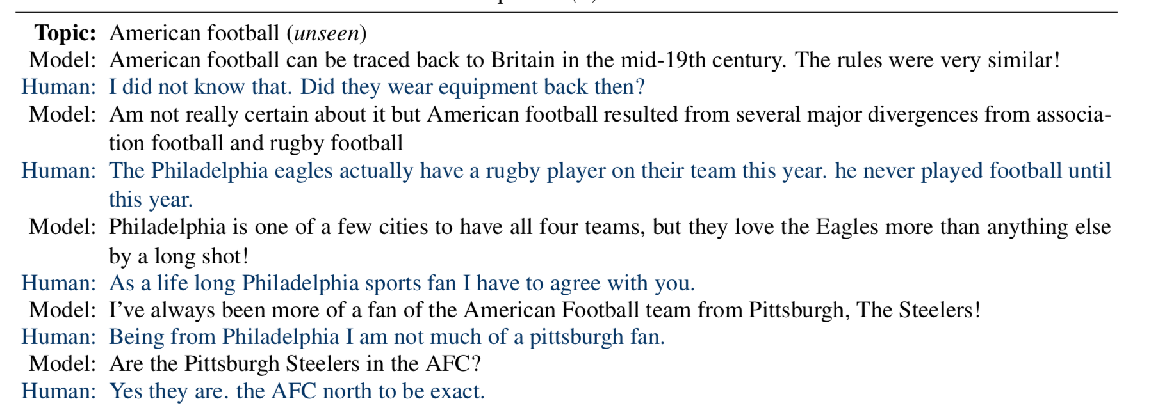
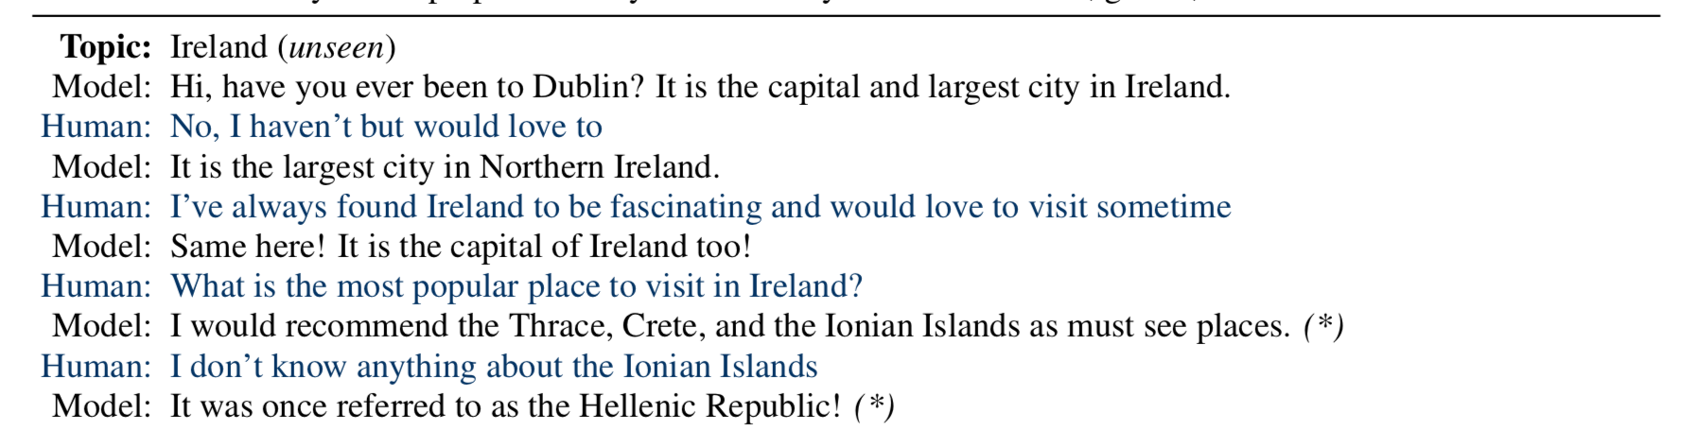

Slide 26
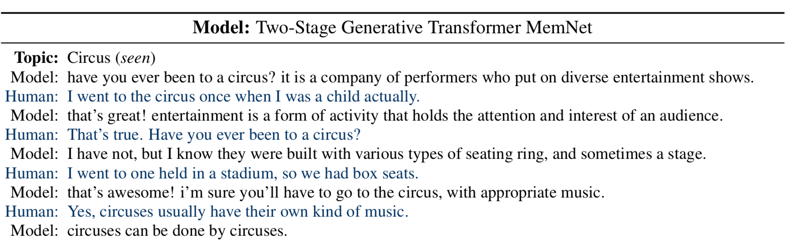
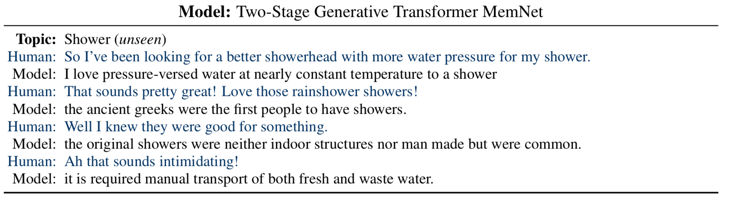

Slide 27
Error Analysis Summary
Retrieval models are surprisingly good on seen topics (not always of course)
On unseen, they can fail very badly
Generative models aren’t as good on seen, but can generalize to unseen.
They still suffer from several problems (fixes: open research problems):
local & global repetition in dialogue, fixed to some extent by knowledge grounding
too much reliance on copying (“I don’t know, but I do know that [Wikipedia excerpt] “)
clearly not as engaging as retrieval, but catches up on unseen
balance issues: too many statements, not enough questions

Slide 28
Natural Language Generation task spectrum
Machine Translation
Sentence Compression
Abstractive Summarization
Chitchat
Dialogue
Story Generation
Less open-ended
More open-ended
Mostly word-level decisions
Requires high-level decisions
Seq2seq more successful
Seq2seq less successful
more research needed!
Our projects are here
Slide from Abigail See

Slide 29
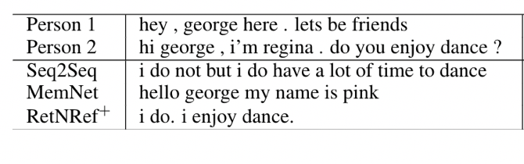
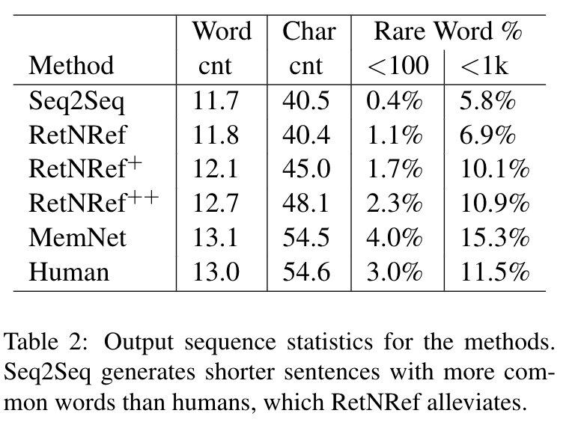
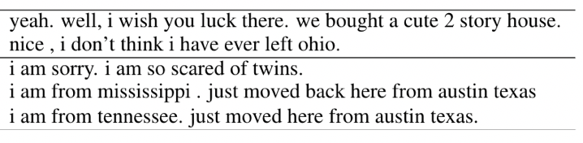
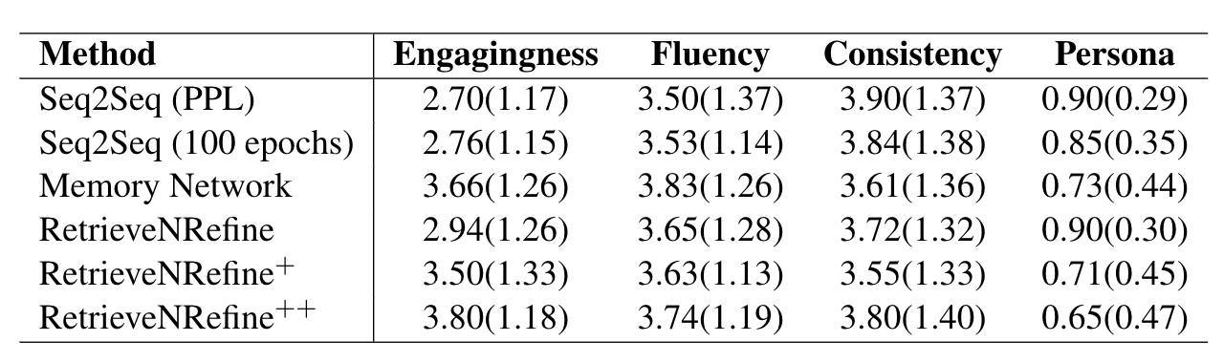
Retrieve & Refine
Jason Weston, Emily Dinan, Alex Miller
Retrieval models: engaging, but sometimes weird results, can’t make new text
Generative models: “I don’t know” problem, short sentences, common words, boring
Combine them!!!
Variants:
RetNRef First Version
RetNRef+ Reweight to Pay more attention to retrieval
RetNRef++ Fix ‘Exact’ Copies of Retriever
Conclusions:
- RetNRef word statistics look more similar to human sequences than Seq2Seq
- Humans prefer RetNRef over Seq2Seq and retrieval MemNet
Human Evaluations
Prefer RetrieveNRefine

Slide 30

Conclusion
Models:
Need to be engaging:
(i) fun to talk to,
(ii) expert/knowledgeable
Open problems:
- Improve generative models to level of retrieval models
- Generalize well to unseen topics
- Natural to multitask with other tasks, e.g. get strong QA performance

